Slide 1
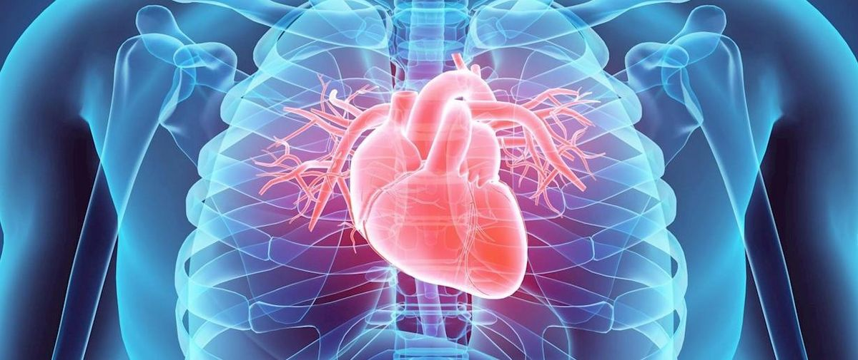

Group – 44 Hari Sai Palem 0747511 Manoj Reddy Lenkala 0753802 Naveen Kumar Tedla 0753623 Sunil Kumar Vidam 0735027
St. Clair College of Applied Arts & Technology DAB-304 Health Care Analytics Final Project - Predicting Cardiovascular Risk Using SUPERVISED Machine Learning Algorithms

Slide 2
Content
Introduction
Motivation
Data Sources and Data Description
Data Preparation
EDA
Models
Evaluation
Conclusion

Slide 3
Introduction
Heart disease, also known as CVD, short for Cardiovascular Disease, is one of the principal causes of death in the world. This disease is caused due to various factors related to the body such as Cholesterol, Blood Pressure, Diabetes, Drugs and alcohol. Sometimes people are born with heart disease. The main symptom of a heart disease is ache in the chest, left hand.
As per the World Health Organization (WHO), heart disease is 2nd leading cause of deaths in Canada. People who are 65 years or older are most likely to get affected by a heart disease. Most of the deaths due to heart disease are from low- and middle-income countries. So, financial situation is also a factor.

Slide 4
Motivation
Machine learning in healthcare industry is useful in predicting many health risks, such tumors, diseases and more. By these predictions, doctors can provide valuable insights that help them in diagnosing and treating their patients effectively.
We will build the models using the machine learning algorithms to predict the target variable and test them using performance metrics and finally compare accuracies of all models to find the better one

Slide 5
Data Source and Description
Kaggle is the source for the dataset.
There are 12 variables in the data set. Of them, the first variable is id.
Remaining features are categorized into 3 types.
Age, height, weight, and gender come under the objective type. Systolic blood pressure (ap_hi), diastolic blood pressure (ap_lo), cholesterol and glucose are examination features.Smoking, Alcohol intake, activity are the subjective features.
The target feature is cardio i.e., the presence/absence of cardiovascular disease.

Slide 6
Data PREPARATION
Checked for the null values in the dataset but didn’t find any.
Dropped the id column as it will be of no use in the prediction of the disease.
Then, we checked for duplicates and removed them.
Outliers removed.
Checked if there is class balance in the data.
Data is split in two different ratios; 75:25 (default) and 80:20.

Slide 7
EDA
Performed the Exploratory Data Analysis (EDA) to summarize the main characteristics of the data visually as follows.
Plotted the heat map for finding out the correlation between the features. Examined how age, weight affected the target feature (cardio).
Explored the distribution of presence/absence of CVD for the features gender, cholesterol, glucose, smoking, alcohol intake, physical activity.
Studied the distribution of gender for people with presence of CVD, for the characteristics like smoking, alcohol consumption, and physical activity.

Slide 8
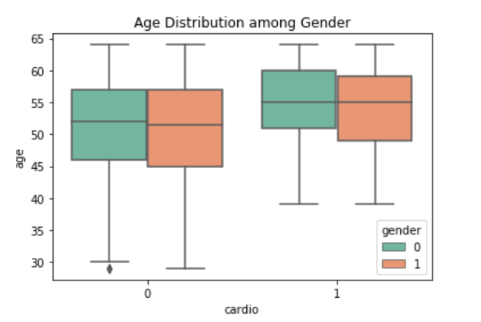
EDA
The boxplots represent the distribution of age and gender with cardio vascular risk.
From patients having cardio vascular disease. We see females are bit higher than males.

Slide 9
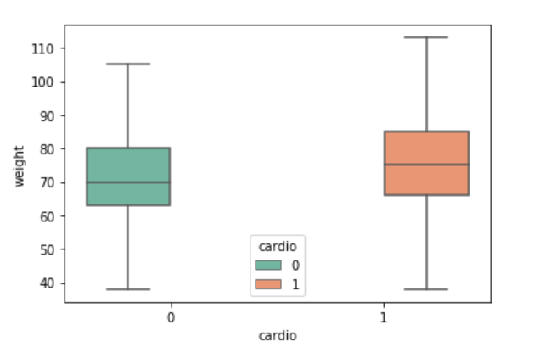
EDA
The boxplot illustrates the Weight distribution for presence/absence of cardiovascular risk.
The patients with cardiovascular risk weigh more than the patients with no risk.

Slide 10
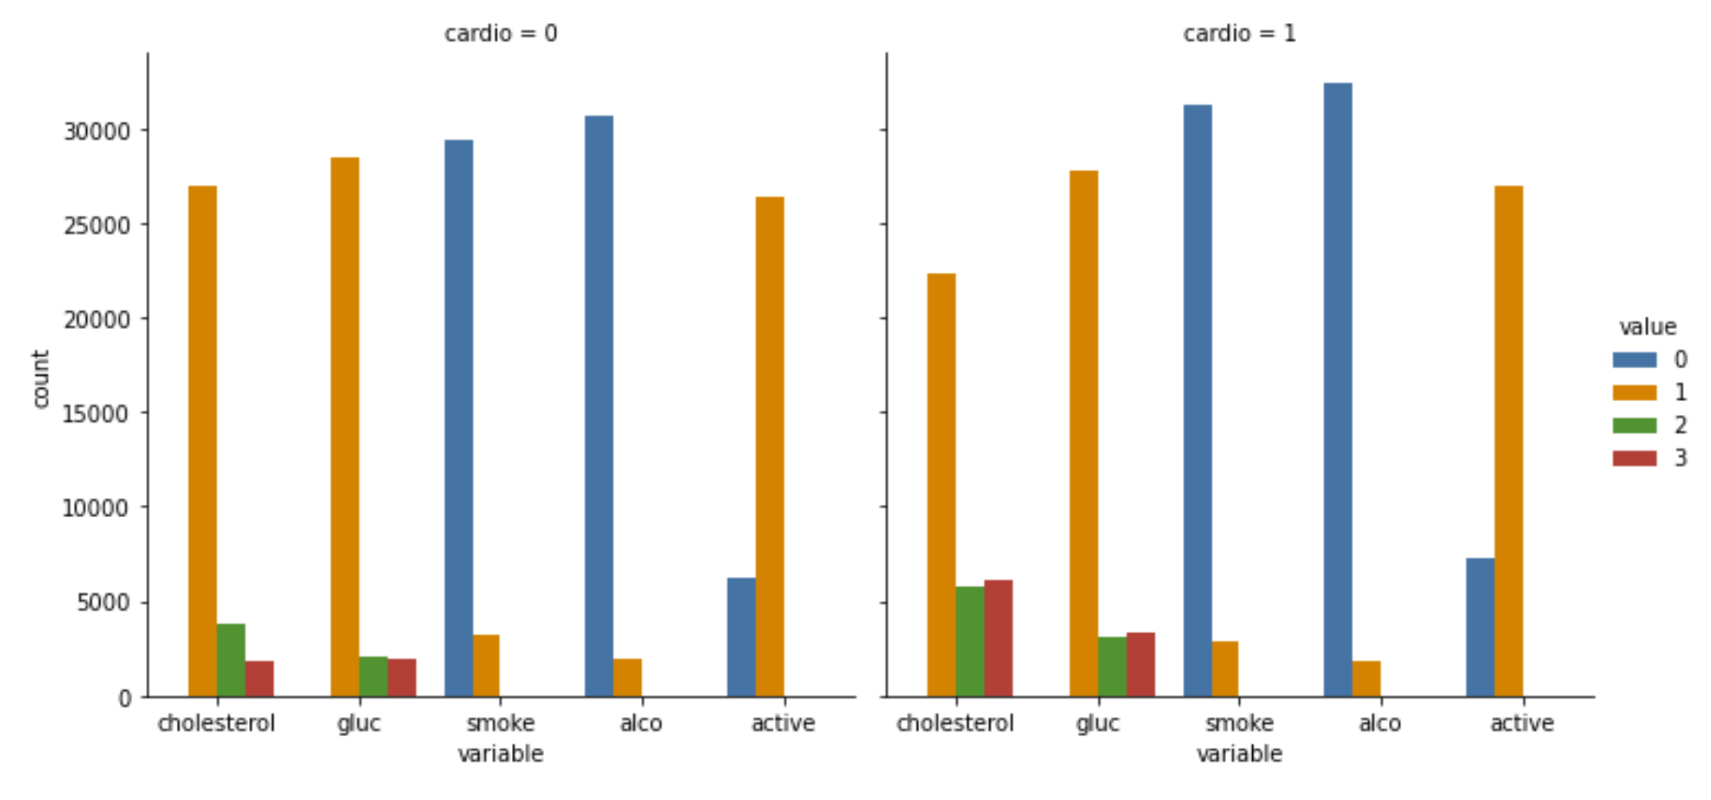
EDA
The bar plot represents the distribution of count for the features; cholesterol, glucose, smoking, alcohol intake, and physical activity for patients with and without cardiovascular risk.
The cholesterol severity, glucose for patients with cardiovascular risk is higher.
The cardiovascular risk is high for patients with less or no physical activity.

Slide 11
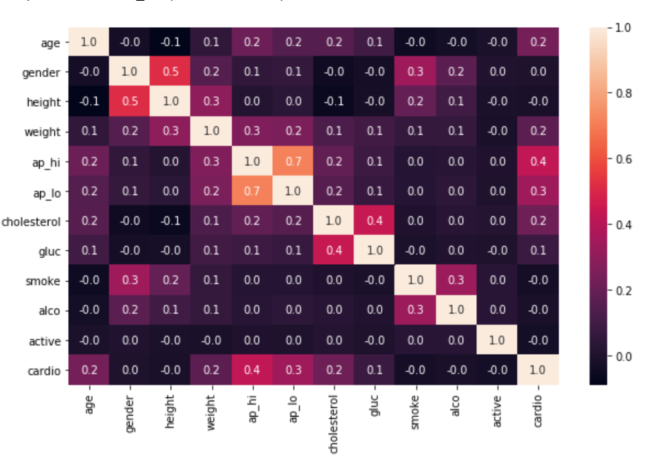
EDA
The image represents the correlation matrix plotted between all the features in the dataset.
The strong positive correlation exists between systolic and diastolic blood pressures.
The negative correlation exists between height and cholesterol

Slide 12
Models
Logistic Regression
KNN Classifier
SVM Classifier
Naïve Bayes Classifier
Random Forest Classifier
XGBoost

Slide 13
Models
Each model is trained using two different split ratios; 75:25 and 80:20 with default parameters.
For the default split, the accuracies we obtained seemed low.
To improve the accuracy we have performed Hyper parameter tuning for random forest and XGBoost.

Slide 14
Evaluation
For dataset with almost class balance, only accuracy is taken into consideration.
Plotted confusion matrix to evaluate both type 1(False Positive) and type 2 errors(False Negative)
Type 2 errors must be less when compared to type 1 errors

Slide 15
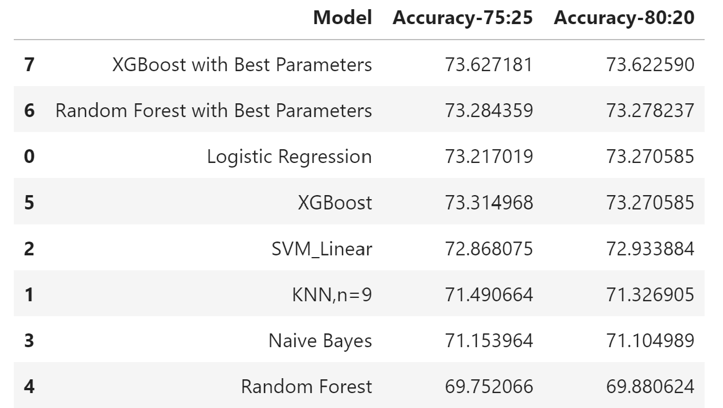
Evaluation
Models with their Accuracies are plotted in descending order.
Accuracies are plotted for both 75:25,80:20 split ratios

Slide 16
Conclusion
Best model – Highest accuracy is obtained for XGBoost with best parameters. In the case of false negatives (type 2 error), random forest with best parameters has low false negatives for 80:20 split ratio and the accuracy is almost same for both the models. So, we consider random forest classifier model as the best model.
Machine learning in healthcare is not being used up to the standards but once used to its potential, it will lead a huge revolution in this field.

Slide 17
Machine Learning in Healthcare Analytics
- The Future with Possibilities

Slide 18
Thank You - Group 44

